Slide 1
Table of Contents
Objectives
Current State: Databricks Clusters in DEV
Unity Catalog differentiator : Without and With
Unity Catalog: Architecture
Next Steps and Timelines

Slide 2
Objectives
Problem Statement
Proposed Solution: Upgrade to Unity Catalog
Hyperscale clusters, which have been deprecated* by Databricks, are used to provide data security for Hive tables in the refined zone.
User management, metadata, and access control for Hyperscale clusters are not handled centrally, but rather at the workspace level.
An additional cluster is required to handle the external Hive meta-store.
Hive is not tightly integrated with Databricks thus lags enterprise level security.
User management, metadata, and access control are managed at account level; thus, security is centralized.
Since Unity Catalog is tightly integrated with Databricks it provides enhanced data security and governance capabilities, including data lineage tracking, data discovery, and access control within Databricks, which are not available in Hive.
Unity Catalog integrates with Collibra.
It gives complete control over across DEV, PRE-PROD, and PROD data assets on Data Lake.
* Hyperscale clusters support is available till march, 2025

Slide 3
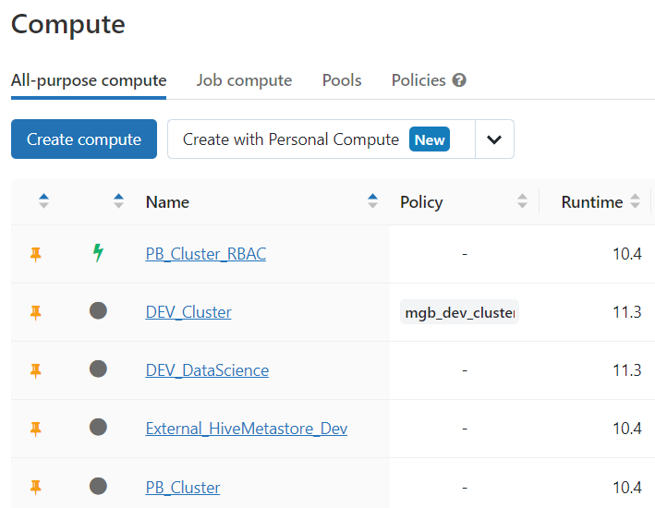
Current State – Databricks Clusters
Table level security not available other than Hyperscale Cluster
Hyperscale Cluster, provides table level access control

Slide 4
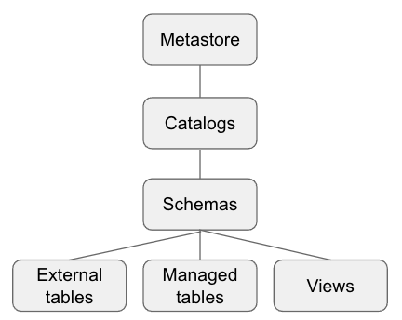
Consistent Data Security Across all Subscription at MGB
One Meta Store for all Databricks Data Assets at MGB
1
M
There can be a Catalog for each business unit
Each Catalog or Business Unit can have multiple database/tables/view
M
M
M
M

Slide 5
Unity Catalog differentiator : Without and With
Existing HIVE Security Setup without Unity Catalog
With Unity Catalog
Unity Catalog
DEV
PRE-PROD
PROD
User/Group
Meta Store
Access Control
User/Group
User/Group
User/Group
Meta Store
Meta Store
Meta Store
Access Control
Access Control
Access Control
DEV
PRE-PROD
PROD
Compute Resources
Compute Resources
Compute Resources
Compute Resources
Compute Resources
Compute Resources

Slide 6
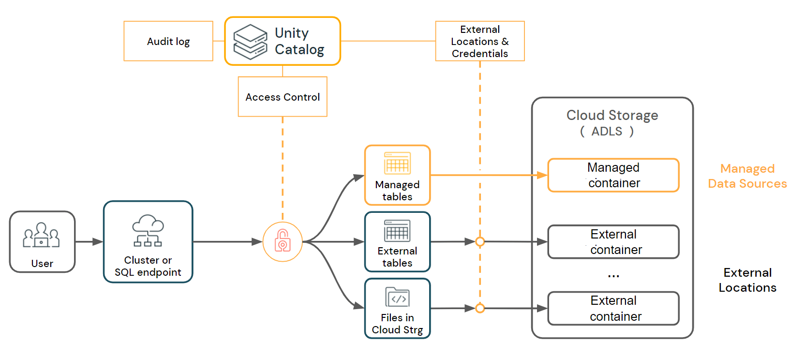
Unity Catalog: Architecture

Slide 7
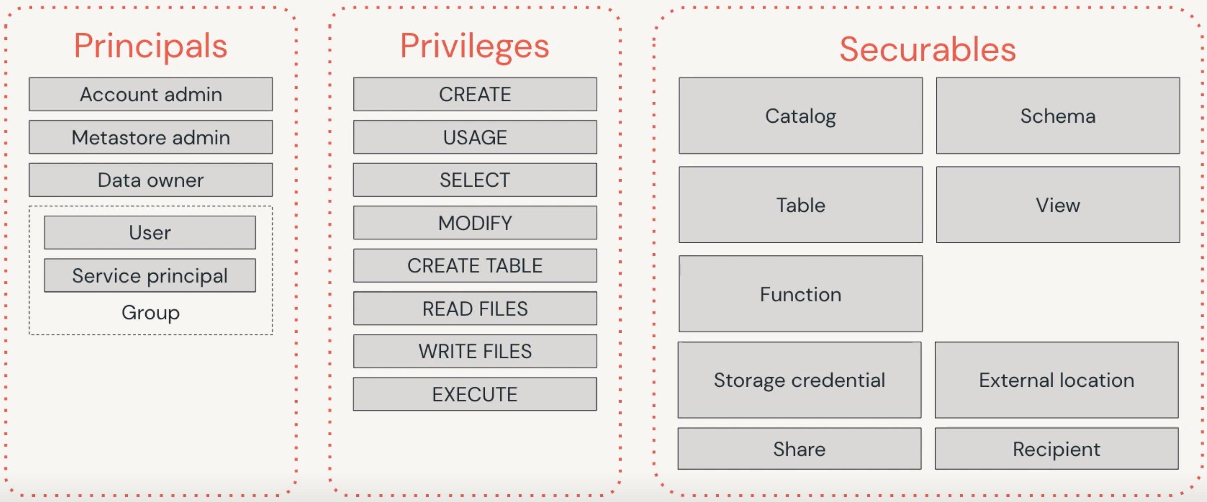
Unity Catalog: Security Structure

Slide 8
Implementation Approach and Timeline
Sprint ? – POC
Identify areas of impact, implementation steps, Integration compatibility with Collibra, existing database and tables migration plan and effort
Sprint ? – Implement Unity Catalog in DEV and test compatibility with Collibra
Sprint ? – Implement Unity Catalog in PRE PROD and PROD, test with Collibra

Slide 9
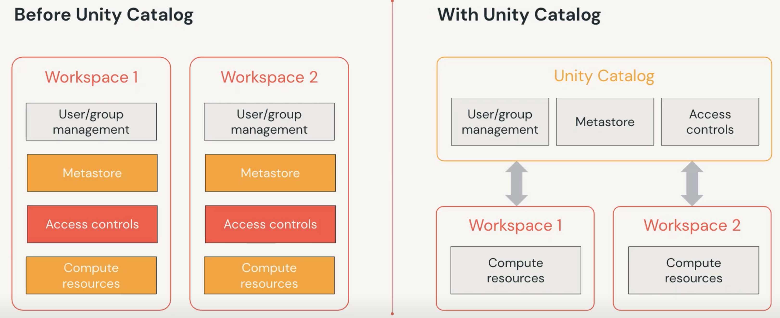
Unity Catalog differentiator : Without and With

Slide 10
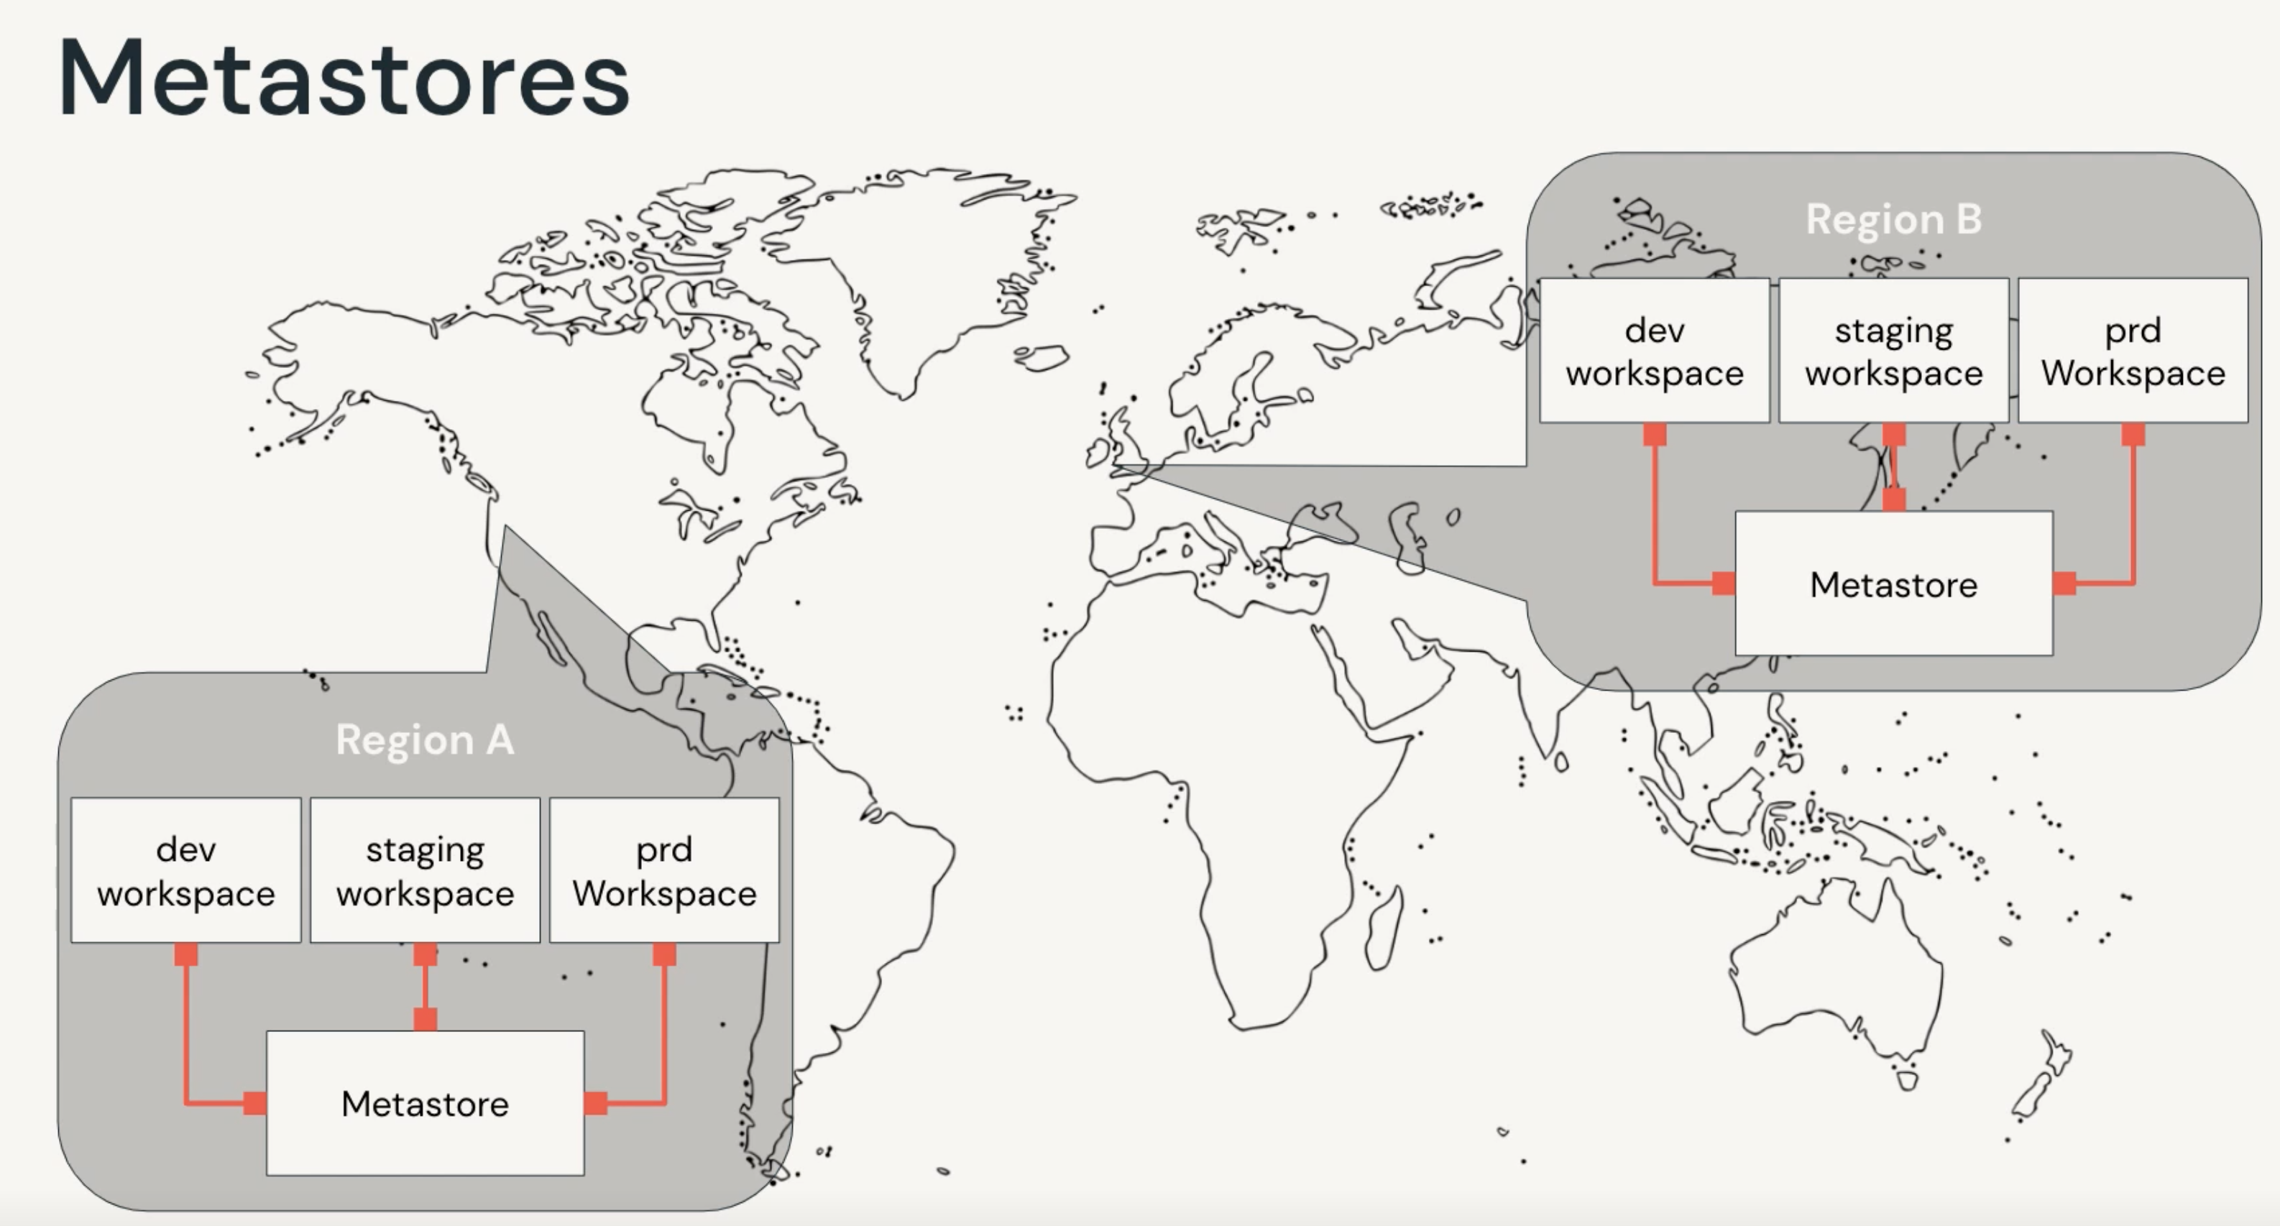
Understanding Unity Catalog: Centralized Control

